Slide 1


Slide 2




Slide 3



BINARY TREES
IN
JAVA

Slide 4
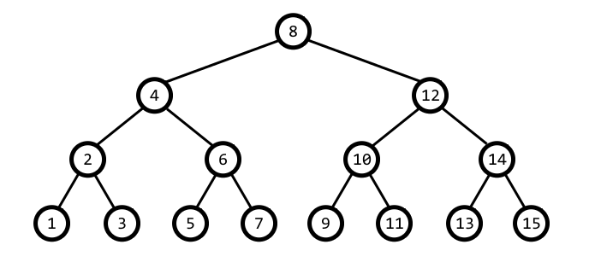
BINARY TREES IN JAVA
A Binary tree is a tree data structure in which each node has at most two child nodes, usually distinguished as “left” and “right”
In a binary tree, a degree of every node is maximum two. A tree with n nodes has exactly n−1 branches or degree

Slide 5
TYPES OF BINARY TREES IN JAVA
FULL BINARY TREE
A Binary Tree is full if every node has 0 or 2 children. We can also say a full binary tree is a binary tree in which all nodes except leaves have two children
COMPLETE BINARY TREE
A Binary Tree is complete Binary Tree if all levels are completely filled except possibly the last level and the last level has all keys as left as possible
PERFECT BINARY TREE
A Binary tree is Perfect Binary Tree in which all internal nodes have two children and all leaves are at the same level

Slide 6
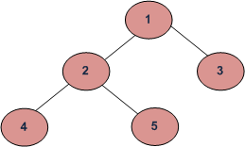
BINARY TREE TRAVERSALS
IPOSTORDER Traverse the left subtree Traverse the right subtree Visit the tree | void printPostorder(Node node) { if(node == null) return; printPostorder(node.left); printPostorder(node.right); System.out.print(node.key + " "); } OUTPUT: 4 5 2 3 1

Slide 7
BINARY TREE TRAVERSALS
IPREORDER ORDER Visit the tree Traverse the left subtree Traverse the right subtree | void printPreorder(Node node) { if(node == null) return; System.out.print(node.key + " "); printInorder(node.left); printInorder(node.right); } OUTPUT: 1 2 4 5 3

Slide 8
BINARY TREE TRAVERSALS
IINORDER ORDER Traverse the left subtree Visit the tree Traverse the right subtree | void printInorder(Node node) { if(node==null) return; printInorder(node.left); System.out.print(node.key + " "); printInorder(node.right); } OUTPUT: 4 2 5 1 3

Slide 9
QUESTION
What is common in three different types of traversals?
A. Root is visited before right subtree
B. Left subtree is always visited before right subtree
C. Root is visited after left subtree
D. All of the above
Answer: B
Notes:
The order of inorder traversal is LEFT ROOT RIGHT The order of preorder traversal is ROOT LEFT RIGHT The order of postorder traversal is LEFT RIGHT ROOT In all three traversals, LEFT is traversed before RIGHT

Slide 10
QUESTION
The inorder and preorder traversal of a binary tree are d b e a f c g and a b d e c f g, respectively. The postorder traversal of the binary tree is:
A. d e b f g c a
B. e d b g f c a
C. e d b f g c a
D. d e f g b c a
Answer: A

Slide 11
QUESTION
Which of the following cannot generate the full binary tree?
A. Inorder and preorder
B. Inorder and postorder
C. Preorder and postorder
D. None of the above
Answer: D
Notes:
To generate a binary tree, two traversals are necessary and one of them must be inorder. But, a full binary tree can be generated from preorder and postorder traversals.

Slide 12
QUESTION
A binary search tree contains the numbers 1, 2, 3, 4, 5, 6, 7, 8. When the tree is traversed in pre-order and the values in each node printed out, the sequence of values obtained is 5, 3, 1, 2, 4, 6, 8, 7. If the tree is traversed in post-order, the sequence obtained would be
8,7,6,5,4,3,2,1
1,2,3,4,8,7,6,5
2,1,4,3,6,7,8,5
2,1,4,3,7,8,6,5
Answer: D

Slide 13
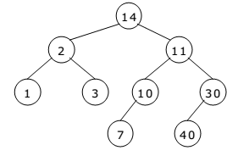
QUESTION
What is the order of nodes visited using a post - order traversal?
14,2,1,3,11,10,7,30,40
1,3,2,7,10,40,30,11,14
1,2,3,14,7,10,11,40,30
1,2,3,7,10,11,14,30,40
Answer: B

Slide 14

THANK YOU

